Slide 1
KATA Bank account

Slide 2
Story map

Slide 3
Expected features perioritized and grouped by MMF/MVP
Deposit
Select account (current / savings…)
Name the deposit
Withdrawal
Enter amount
Select amount
Account statement
Get list of operations (date, amount, balance)
Filter by month
Statement printing
Print as list
Print as designed table
Filter by date
Filter by operation type (Credit/Debit)
Get advanced list of operations (date, credit, debit, balance)
Select type of bills (10,20, 50..)
Check card limit amount
Choose to print or not the receipt
Read bills
Review the amount of deposit
Confirm the deposit
Print a receipt
Select account (current / savings…)
Check common limit amount
Print a receipt
High
necessity
MVP 1
Low
necessity
MMF a

Slide 4
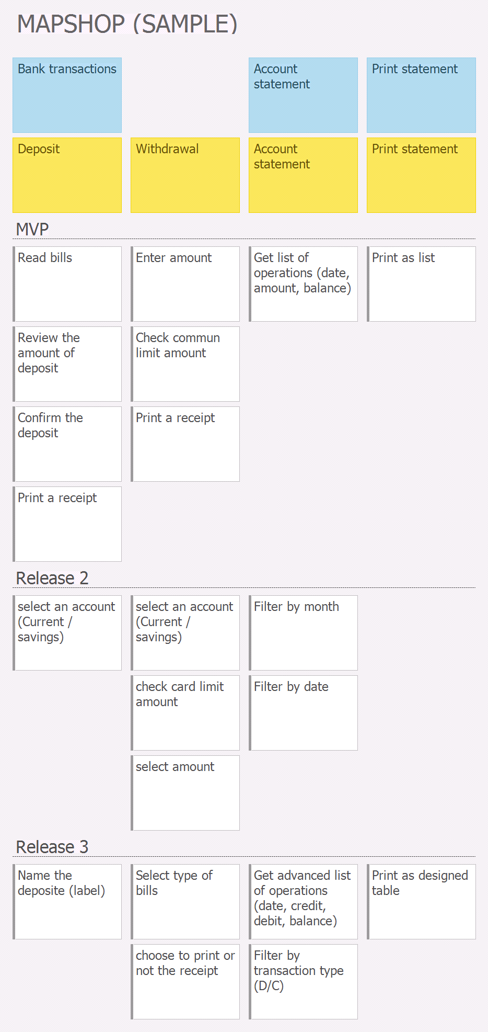

Slide 5
BDD

Slide 6
Business Requirement: Deposit
User story
As an account holder
I want to make a deposit
In order to save money
BDD
Scenario 1: deposit with valid bills
Given my account has 100€
And my bills are valid
When I deposit 50€ in my account
Then My account is increase by 50€
And My balance become 150€
Scenario 2: Deposit with not valid bills
Given the account has 100€
And I have not valid 50€ bill
When I deposit the bill in my account
Then ensure a rejection message is displayed
And my account is not credited

Slide 7
Business Requirement: Withdrawal
User story
As an account holder
I want to withdraw
In order to get cash
BDD
Scenario 1: Balance is sufficient
Given my account has 100€
When I withdraw 20€ from my account
Then decrease my account by 20€
And my balance become 80€
Scenario 2: Balance is insufficient
Given my account has 10€
When i withdraw 50€ from my account
Then ensure a rejection message is displayed
And my account is not debited

Slide 8
Business Requirement: Account statement (1/2)
User story
As an account holder
I want to check the account statement
In order to check the history of my transactions
BDD
Scenario 1: check history after 3 mouvements
Given a client has in his account 100€
And makes a withdrawal of 30€ on 19-01-2018
And a deposit of 20€ on 23-01-2018
And a withdrawal of 10€ on 31-01-2018
When he consult his bank account statement
Then he would see:
date # amount # balance
19-01-2018 # -30 # 70€
23-01-2018 # +20 # 90€
31-01-2018 # -10 # 80€

Slide 9
Business Requirement: Account statement (2/2)
Scenario 2: check February history after 3 movements
Given a client has in his account 100€
And makes a withdrawal of 30€ on 19-01-2018
And a deposit of 20€ on 23-01-2018
And a withdrawal of 10€ on 01-02-2018
When he consult his bank account statement
Then he would see:
date # amount # balance
01-02-2018 # -10 # 80€

Slide 10
Business Requirement: Statement printing
User story
As an account holder
I want to print statement
In order to get my account statement in a paper showing my movements and balance
BDD
Scenario 1: print account statement after 3 mouvements as a list
Given a client has in his account 100€
And makes a withdrawal of 30€ on 19-01-2018
And a deposit of 20€ on 23-01-2018
And a withdrawal of 10€ on 31-01-2018
When he prints his bank account statement
Then he would see on the ticket:
date # amount # balance
19-01-2018 # -30 # 70€
23-01-2018 # +20 # 90€
31-01-2018 # -10 # 80€

Slide 11
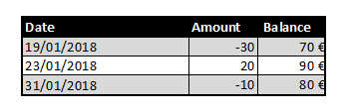
Business Requirement: Statement printing (2/2)
Scenario 2: print account statement after 3 mouvements as a designed table
Given a client has in his account 100€
And makes a withdrawal of 30€ on 19-01-2018
And a deposit of 20€ on 23-01-2018
And a withdrawal of 10€ on 31-01-2018
When he prints his bank account statement
Then he would see on the ticket:

